Slide 1



Programming For Data Analysis (PFDA)
(Individual Presentation)
Presented By:
Presented To:
Lokesh Bhatta (NP000526)
BSc.IT (4th semester)
Dr. RN Thakur
(Module Leader)

Slide 2

Presentation Overview
Introduction
Assumptions
Analysis
Additional features
Conclusion

Slide 3
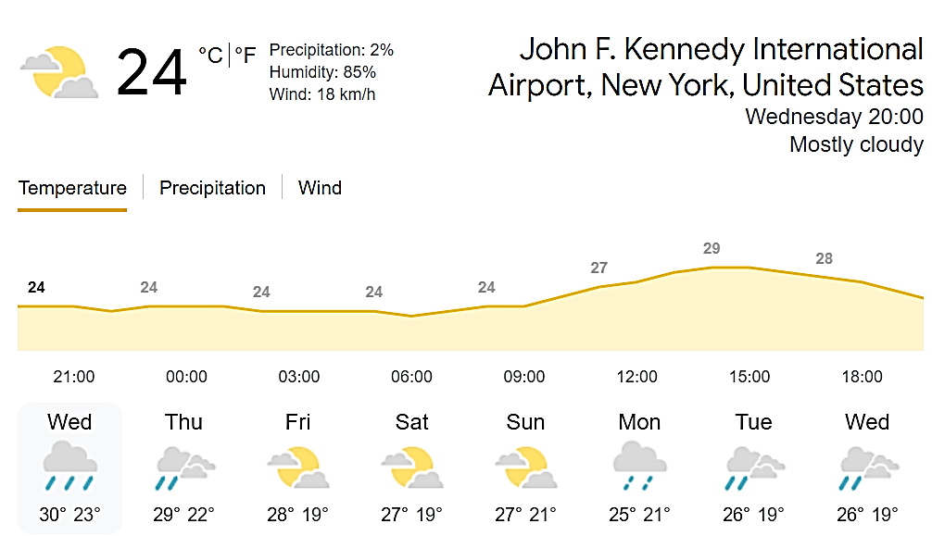
Introduction
This project is to explore the hourly weather data set and categorize it by different techniques which help to do the decision-making.
Concepts of data visualization, exploration, and manipulation techniques in this project.
The dataset provided for this project is related to the hourly meteorological data for LGA and John F. Kennedy International Airport (JFK) in the United States.

Slide 4
Assumption
There will always be some assumed variables.
There was no outside influence or manipulation of the data.
No major meteorological catastrophes, such as hurricanes, storms, or droughts, occurred, and all of the tools and equipment used to collect the data were in flawless functioning order.

Slide 5
Data visualization
Graphical representation of data that could be represented by:
ggplot2 package
Line graph
Bar chart
Histogram
Scatter plot
Box plot

Slide 6
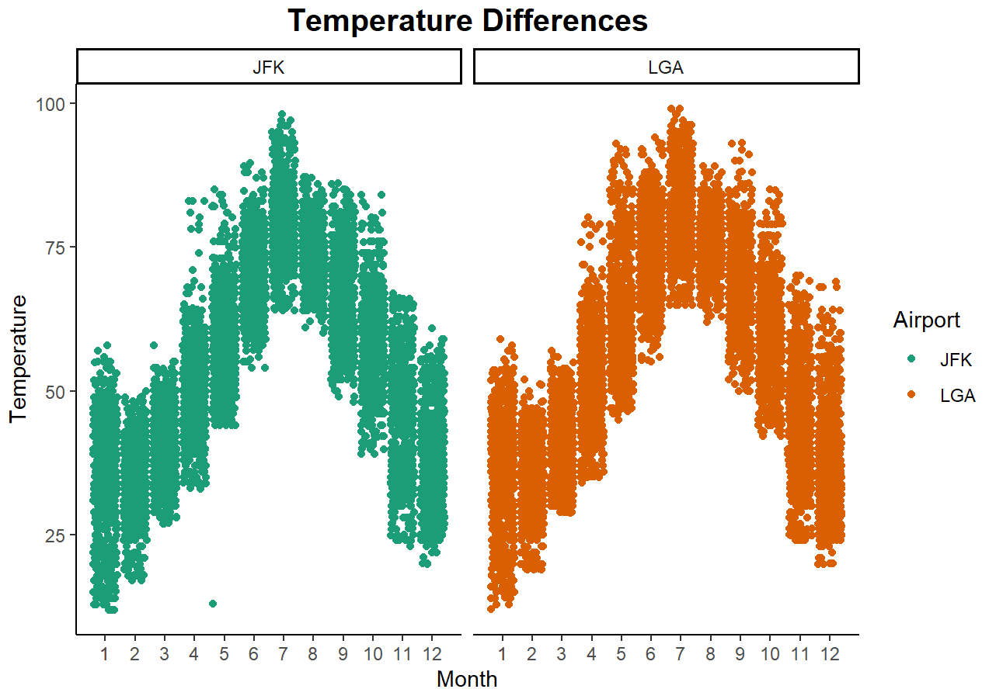
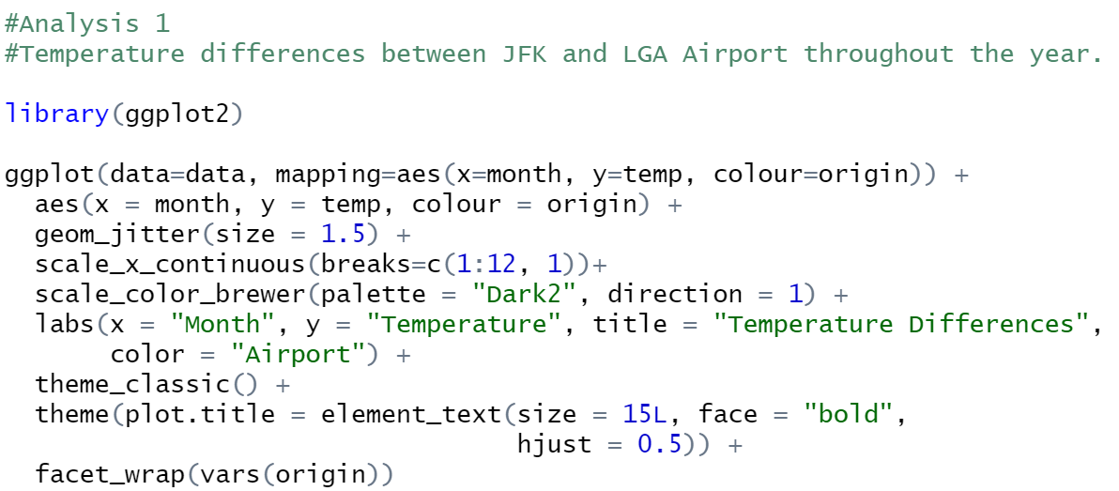
Analysis 1: Temperature difference

Slide 7
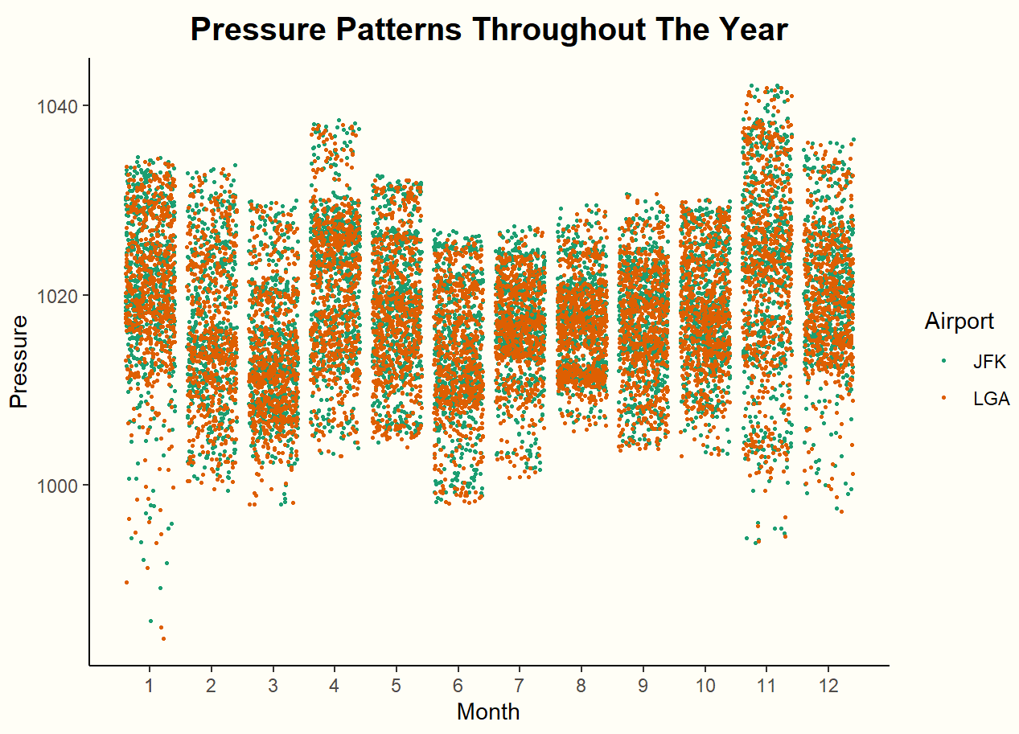
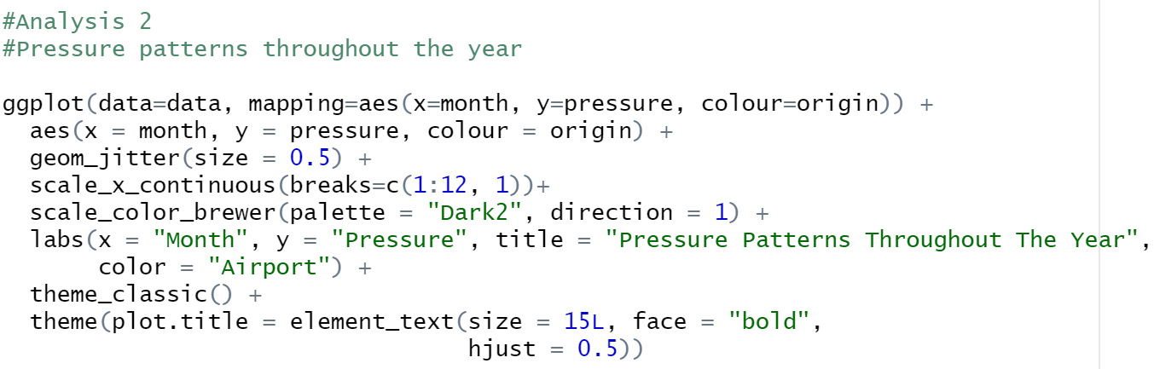
Analysis 2: Pressure pattern

Slide 8
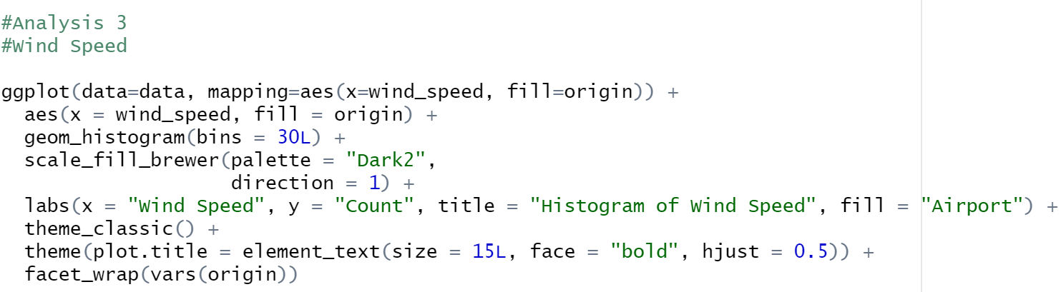
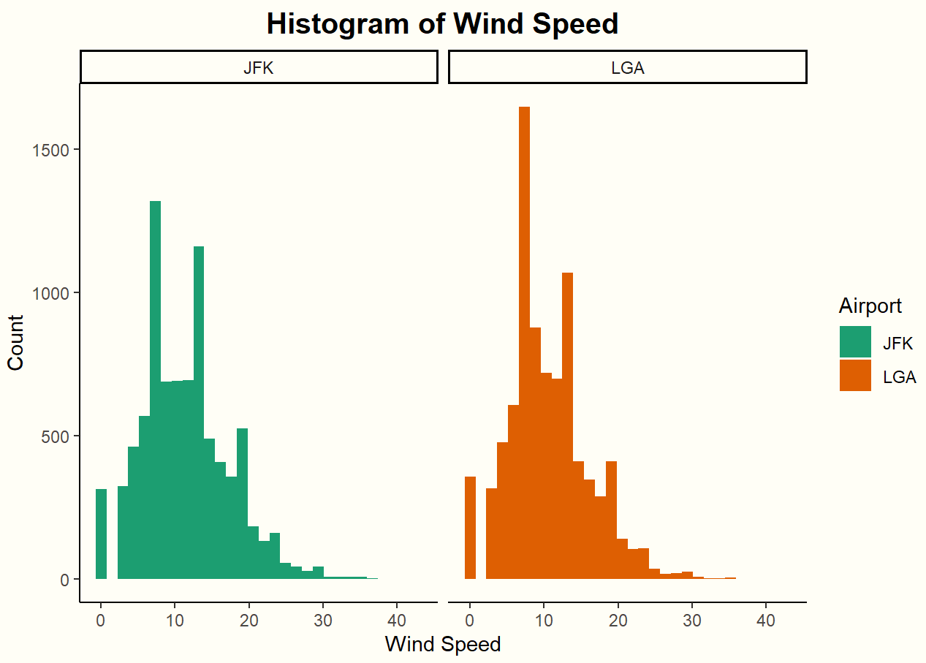
Analysis 3: Wind speed

Slide 9
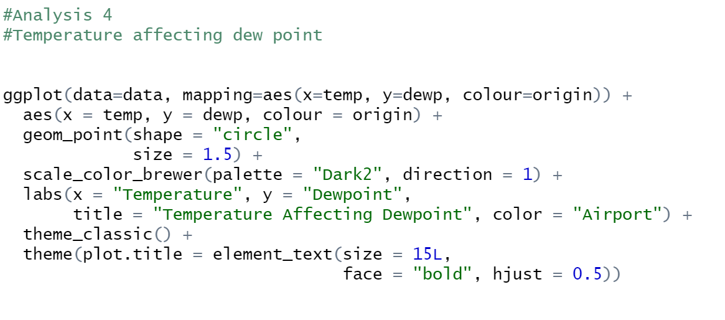
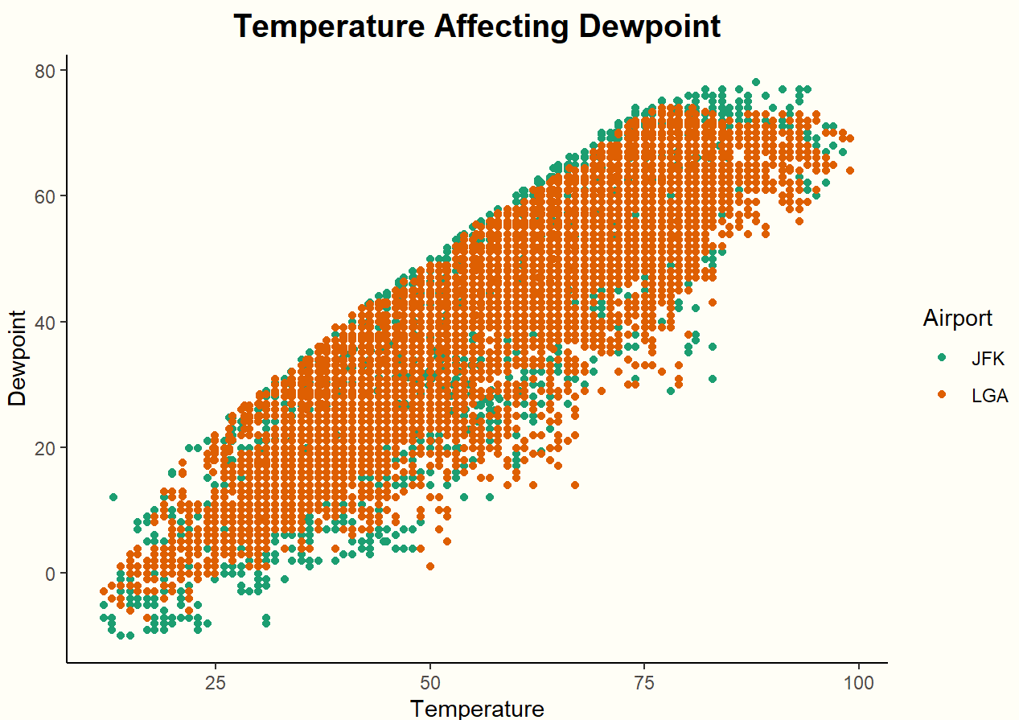
Analysis 4: Temperature affecting dew point

Slide 10
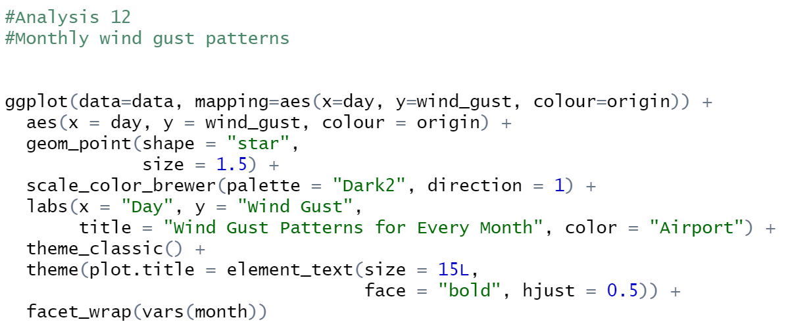
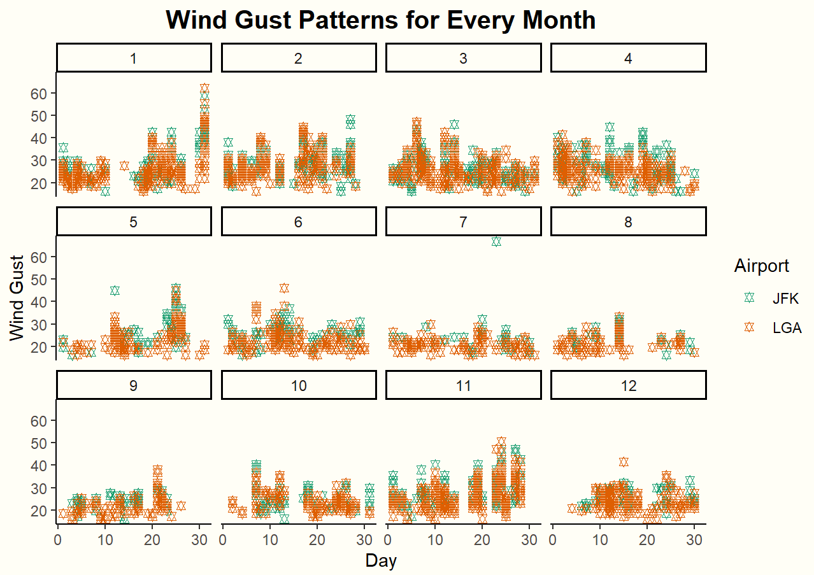
Analysis 5: wind gust pattern

Slide 11
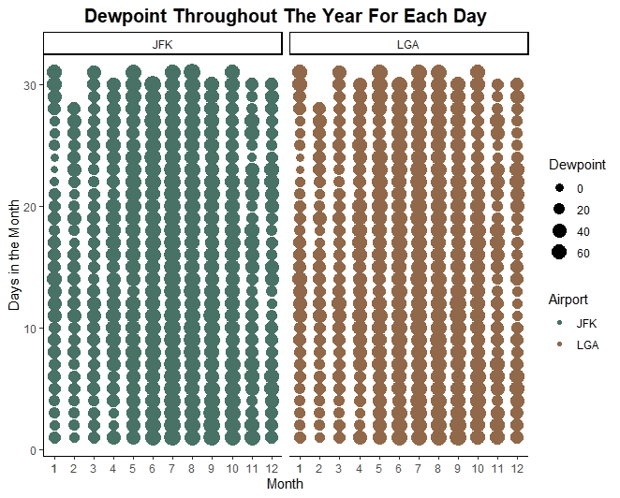
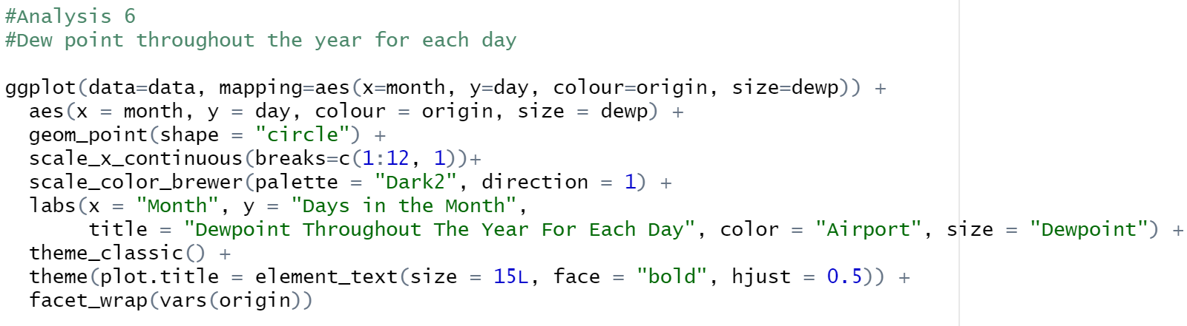
Analysis 6: Dew point

Slide 12


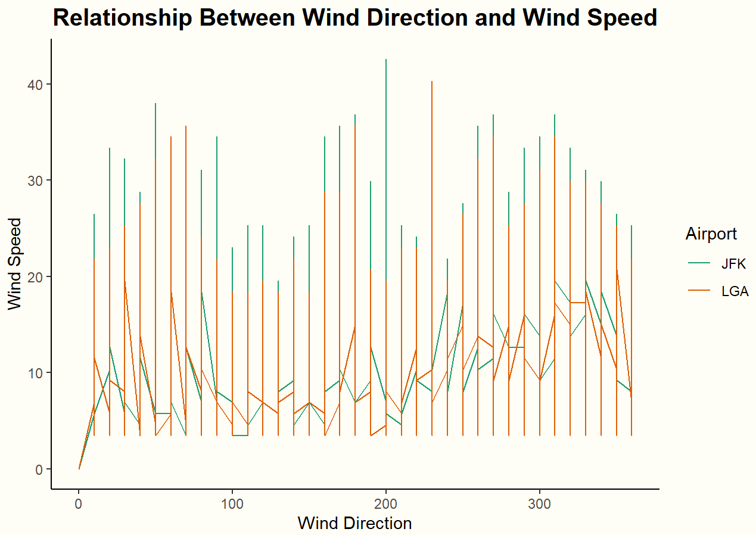
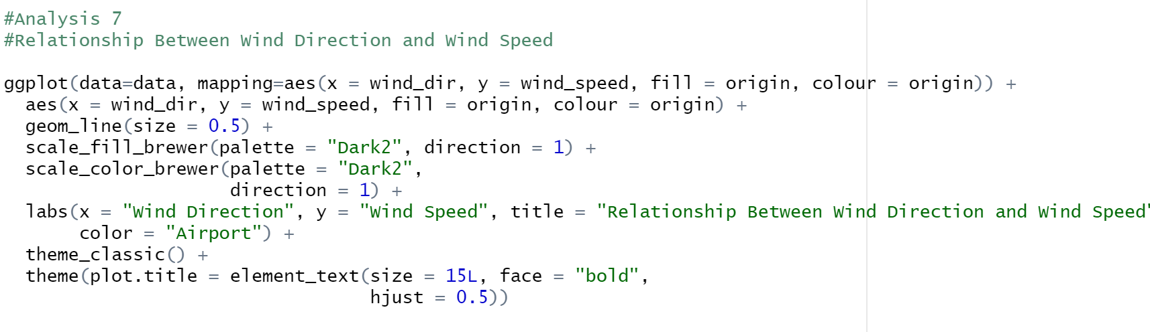
Analysis 7: Wind direction and wind speed relation

Slide 13
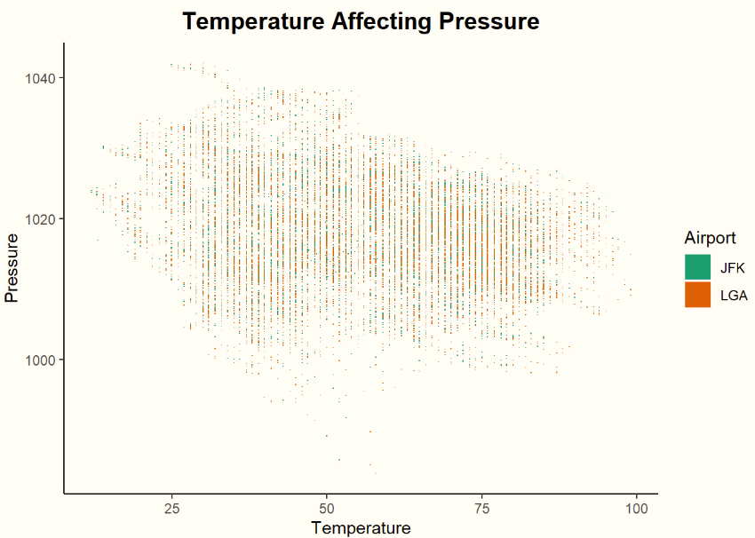
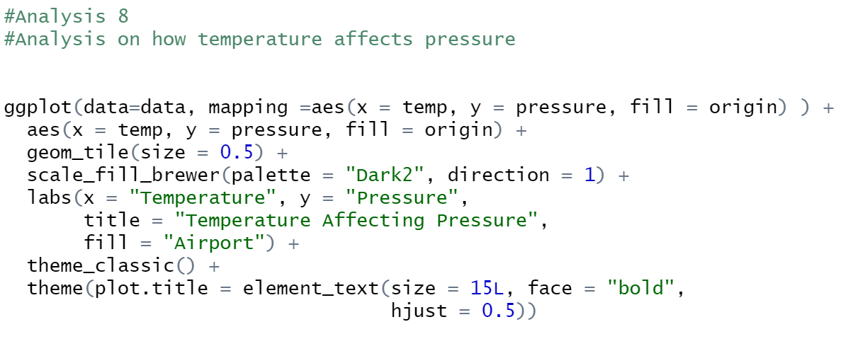
Analysis 8: Temperature affecting pressure

Slide 14
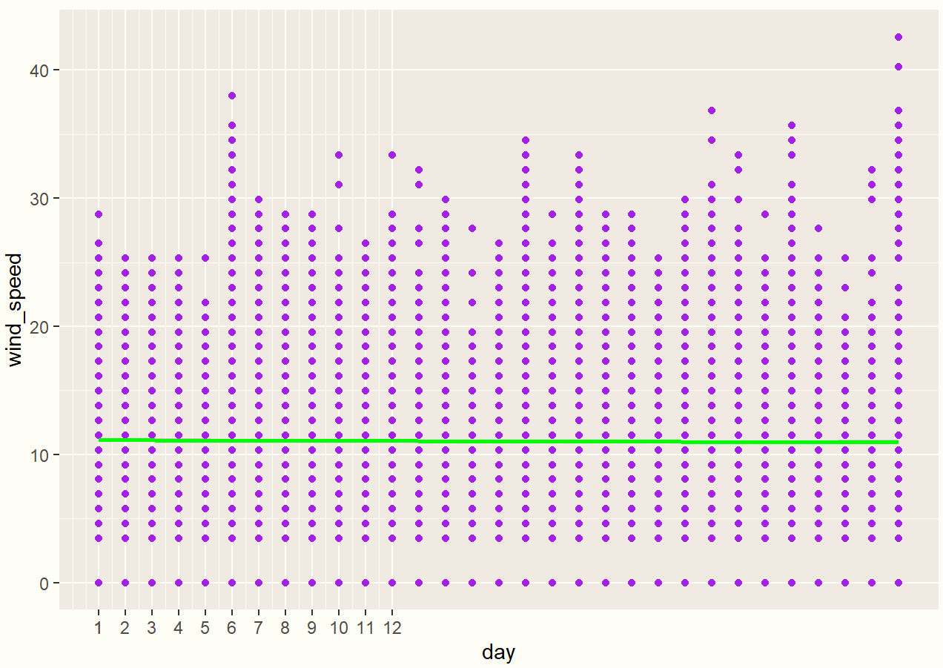
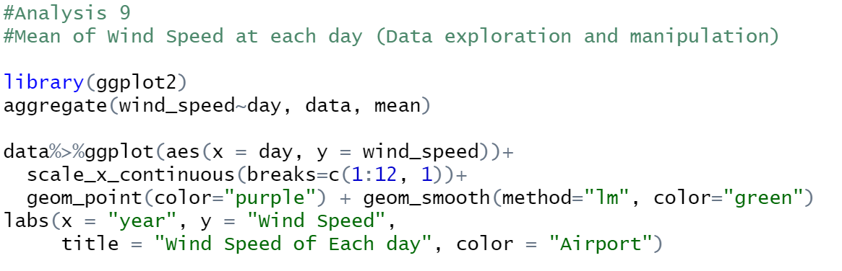
Analysis 9: mean of wind speed

Slide 15
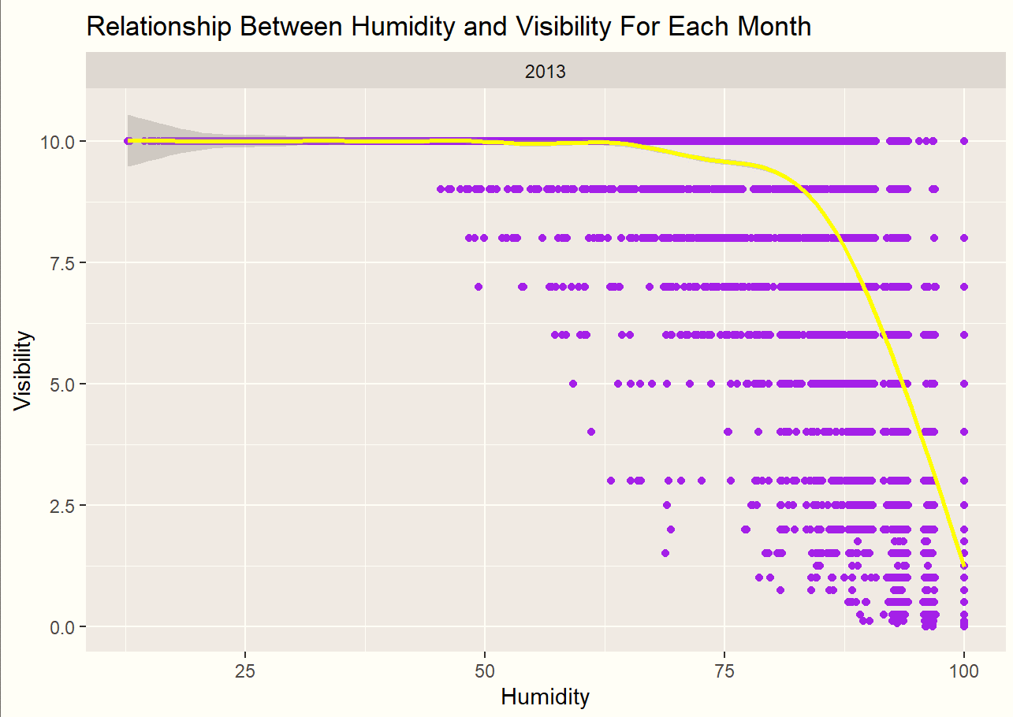
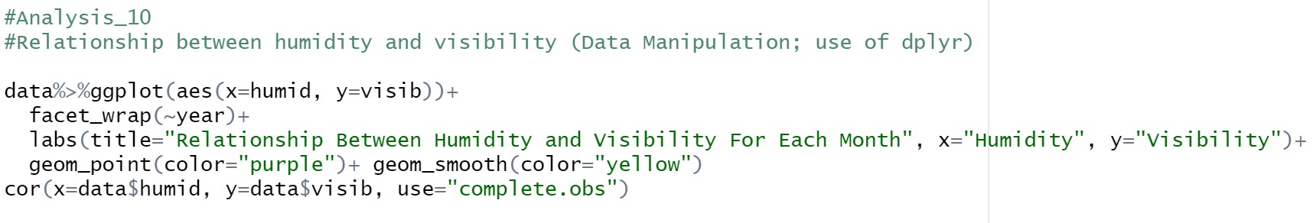
Analysis 10: humidity and visibility relationship

Slide 16
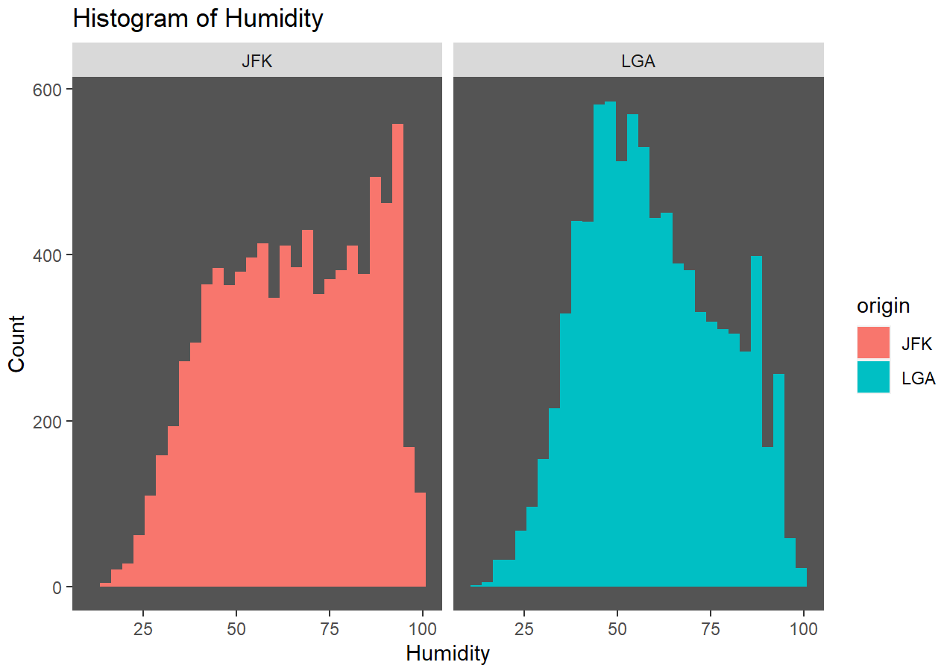
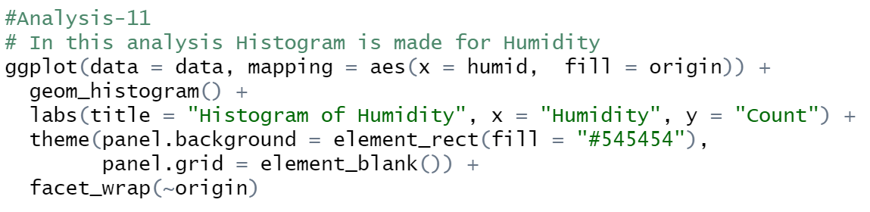
Analysis 11: Humidity histogram

Slide 17
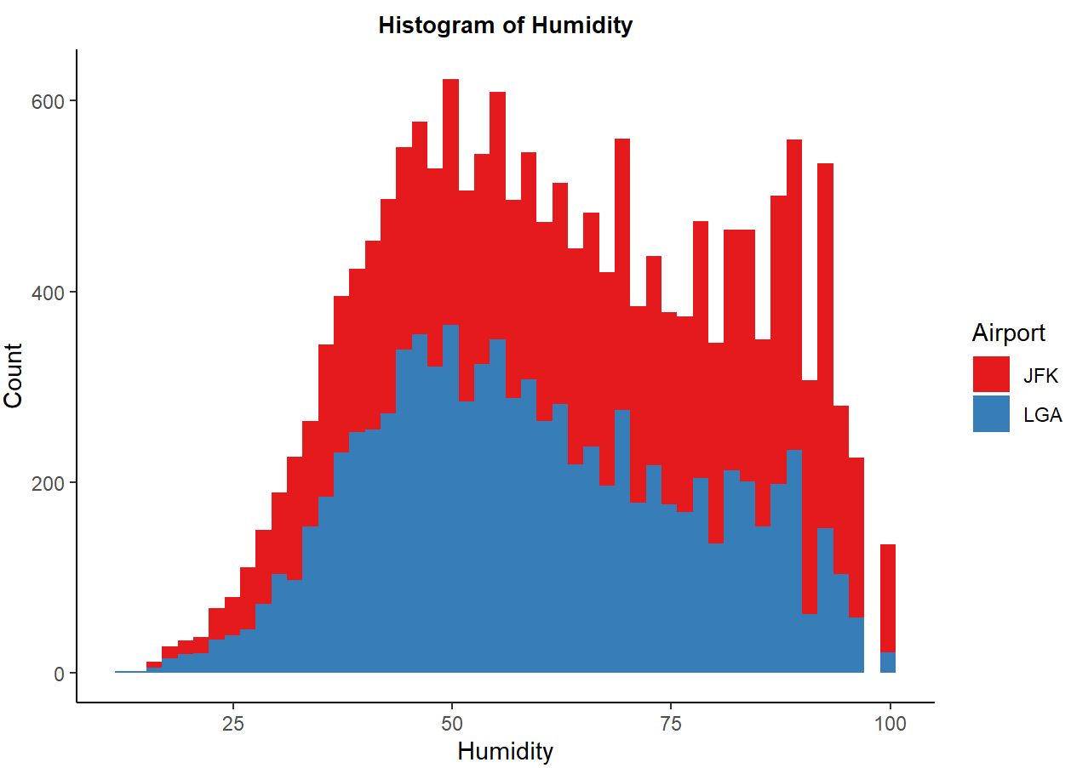
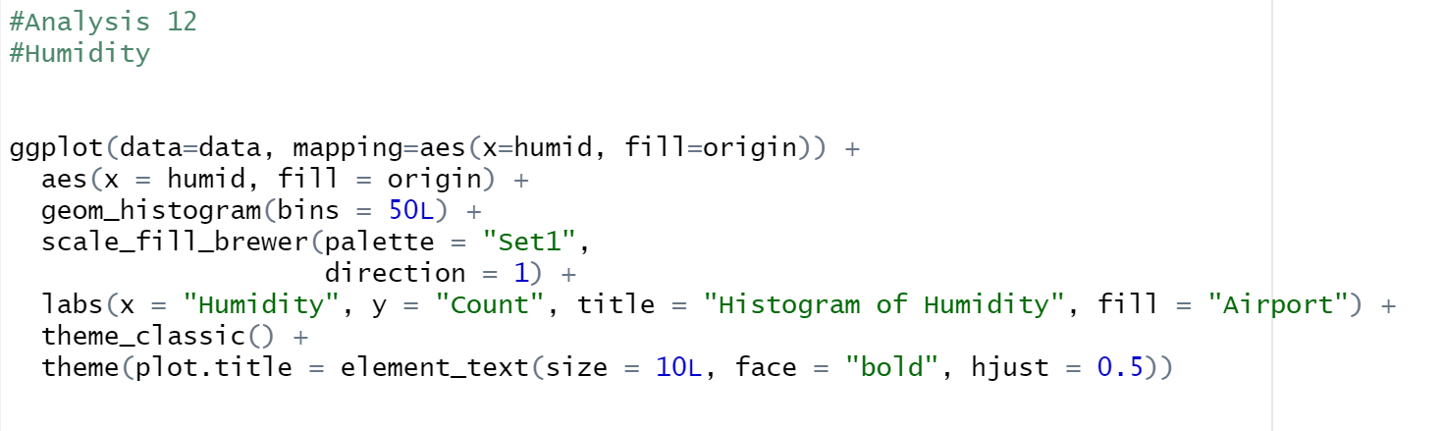
Analysis 12: Humidity

Slide 18
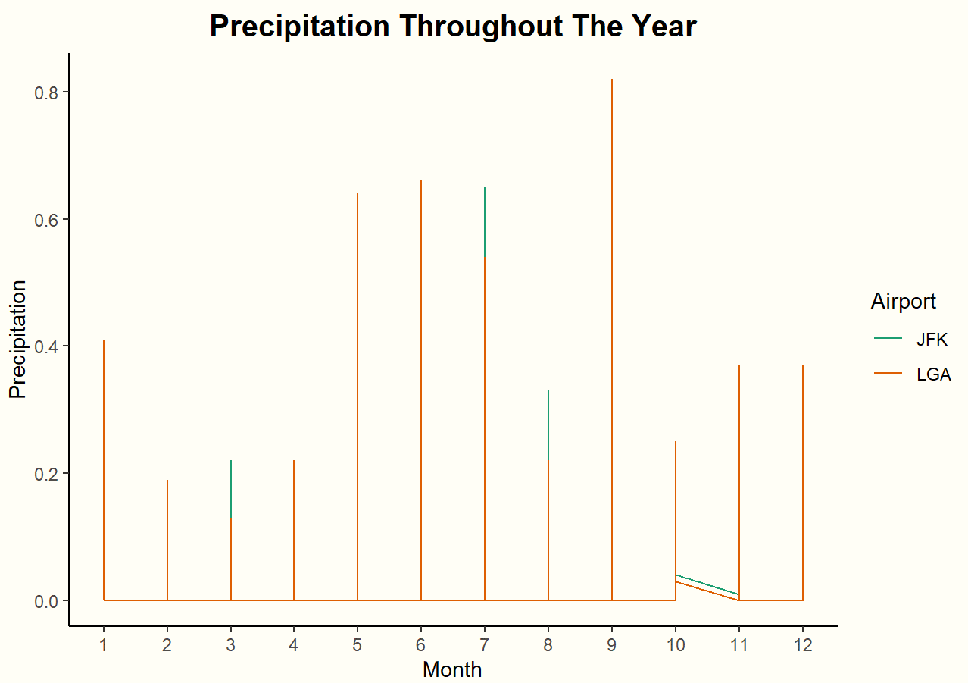
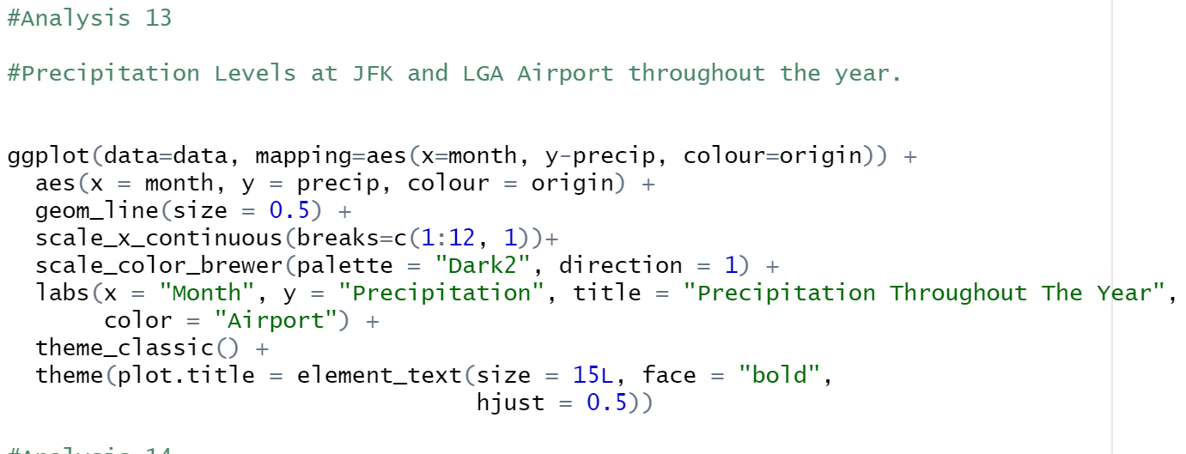
Analysis 13: Precipitation level

Slide 19
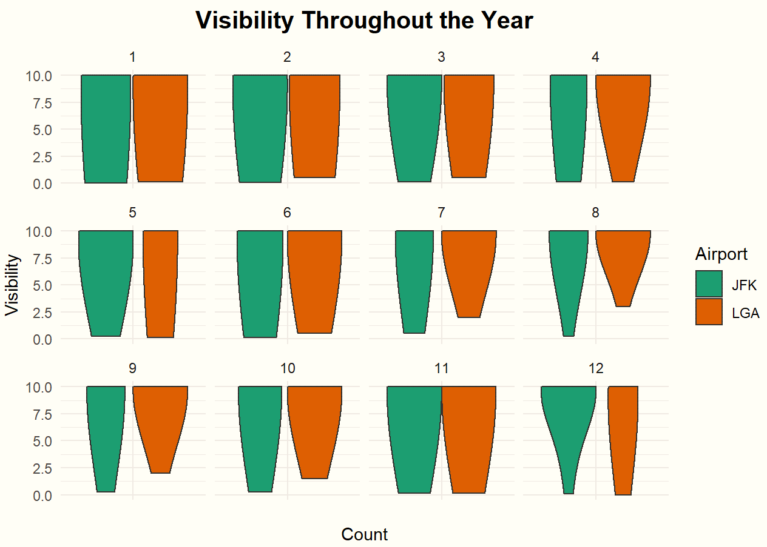
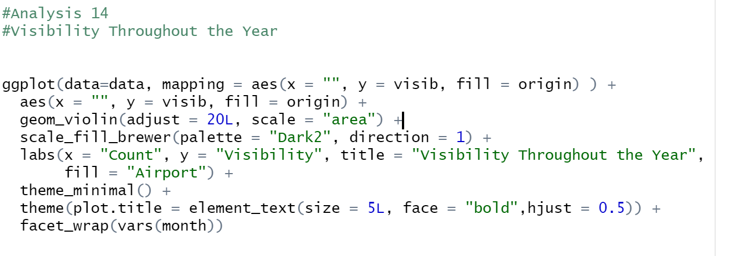
Analysis 14: Visibility

Slide 20
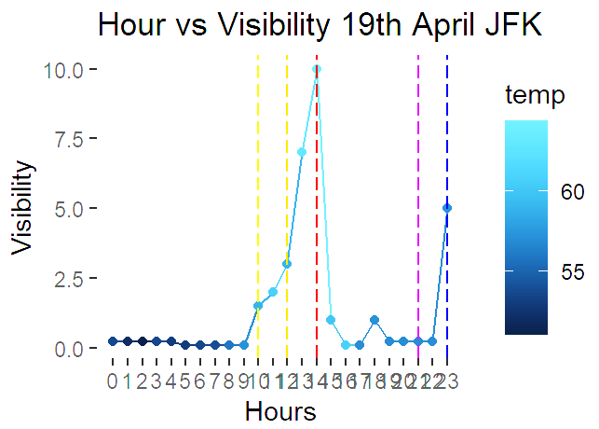
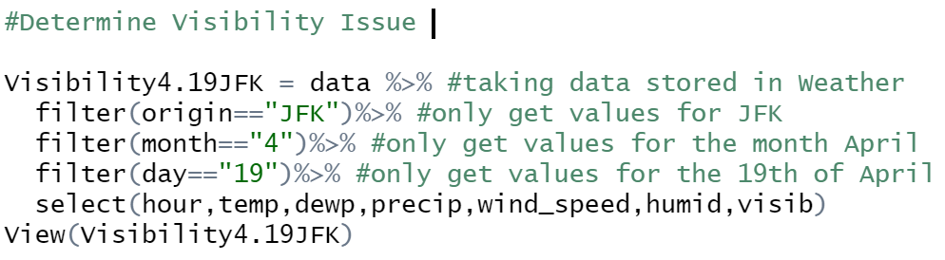
Additional Feature 1: Hours Vs Visibility

Slide 21
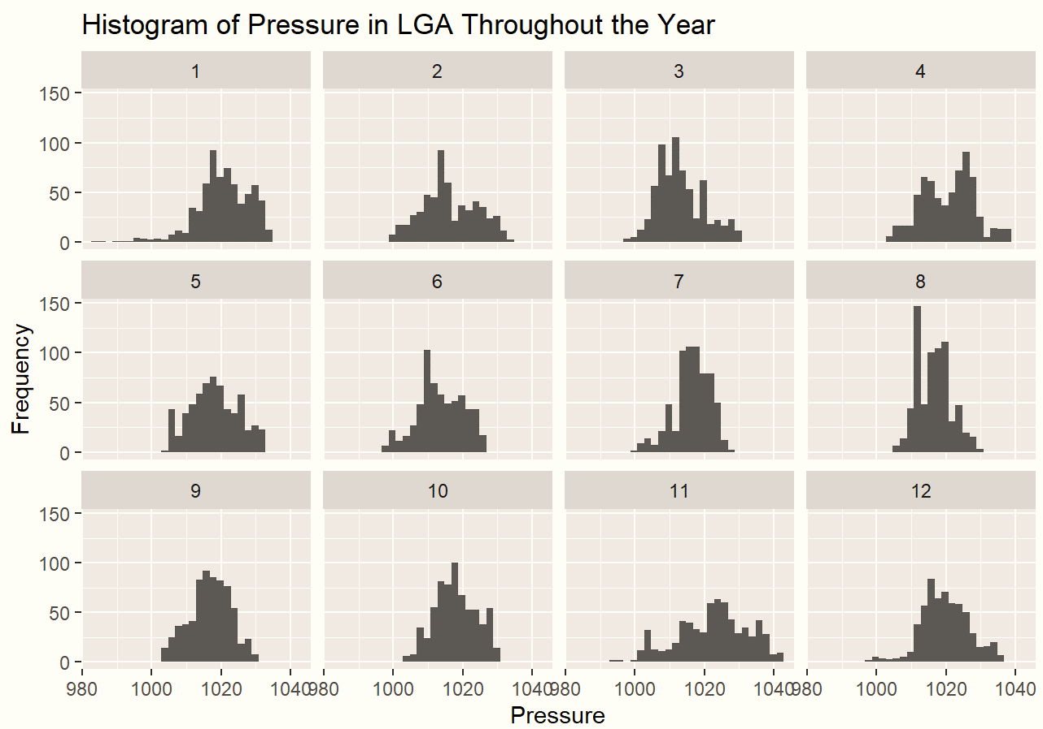
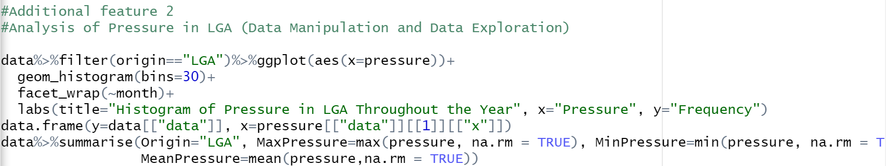
Additional feature 2 : Pressure analysis in lga

Slide 22
Demonstration

Slide 23


Slide 24


